Slide 1
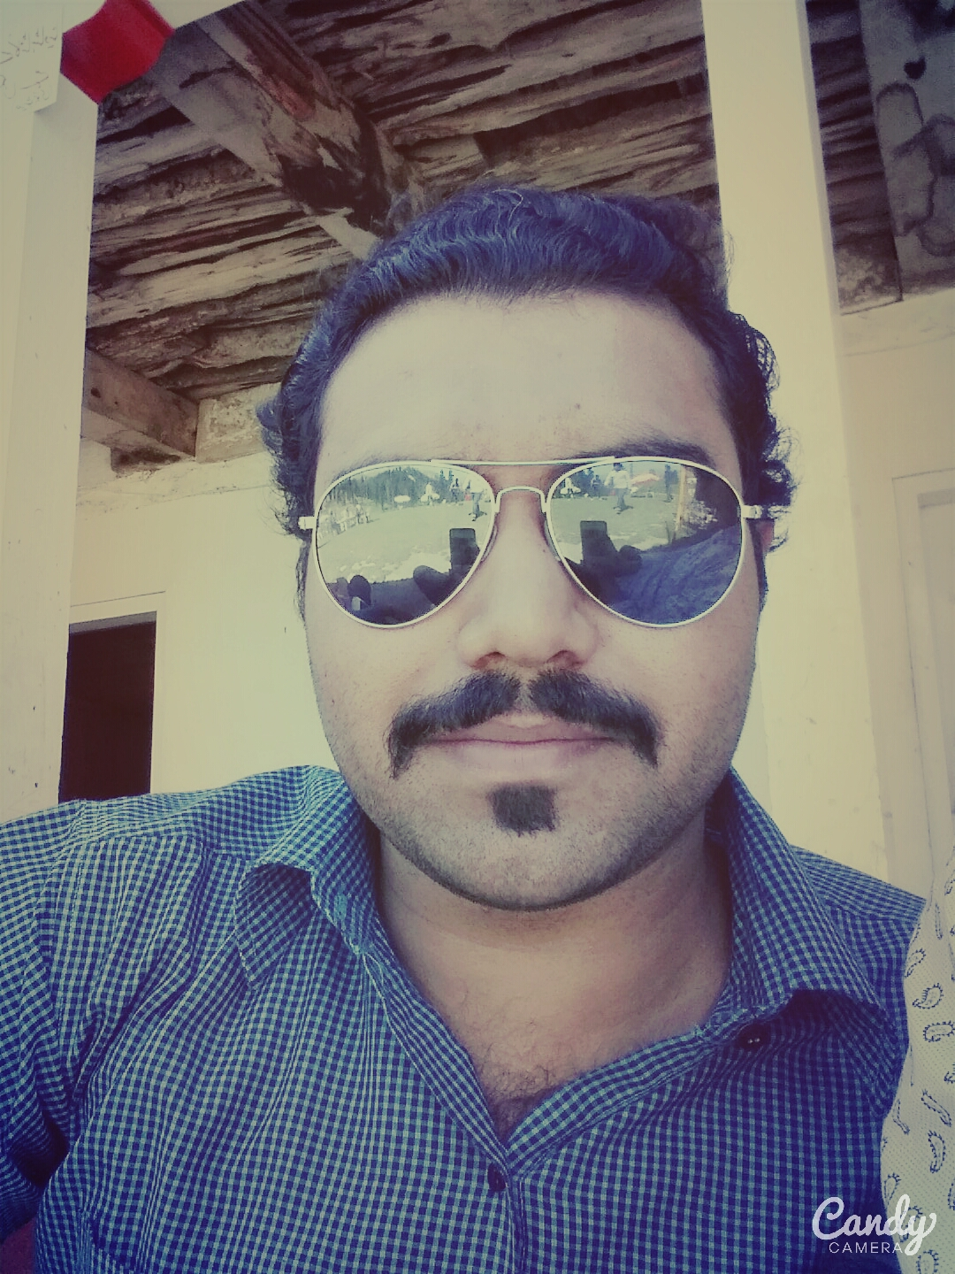



Ahmad Yousaf
Faisal Noor
Low-Fi
Prototype
DastiCafts
Saqib Javed
Umer Ahmad

Slide 2
DastiCrafts
Handicrafts you want
People face difficulty while searching for shops of handicrafts. Sometime people are not able to find artisans who can deliver customized products.
DastiCrafts is a platform where people will be able to find all type of handicrafts and they will be able to order the customized products.

Slide 3
Tasks
Simple
Handmade products can be easily bought from Dasticrafts.
Moderate
People can order different kind of handicrafts in a more organized manner.
Complex
Customers can order the products they want (customized products).

Slide 4
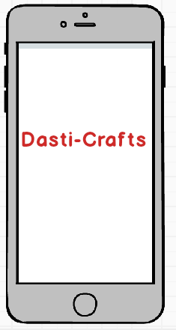
SELECTED INTERFACE & RATIONALE
Place your order
Easy to use
Order number of different kind of handicrafts easily
Order the handicrafts you have been looking for

Slide 5
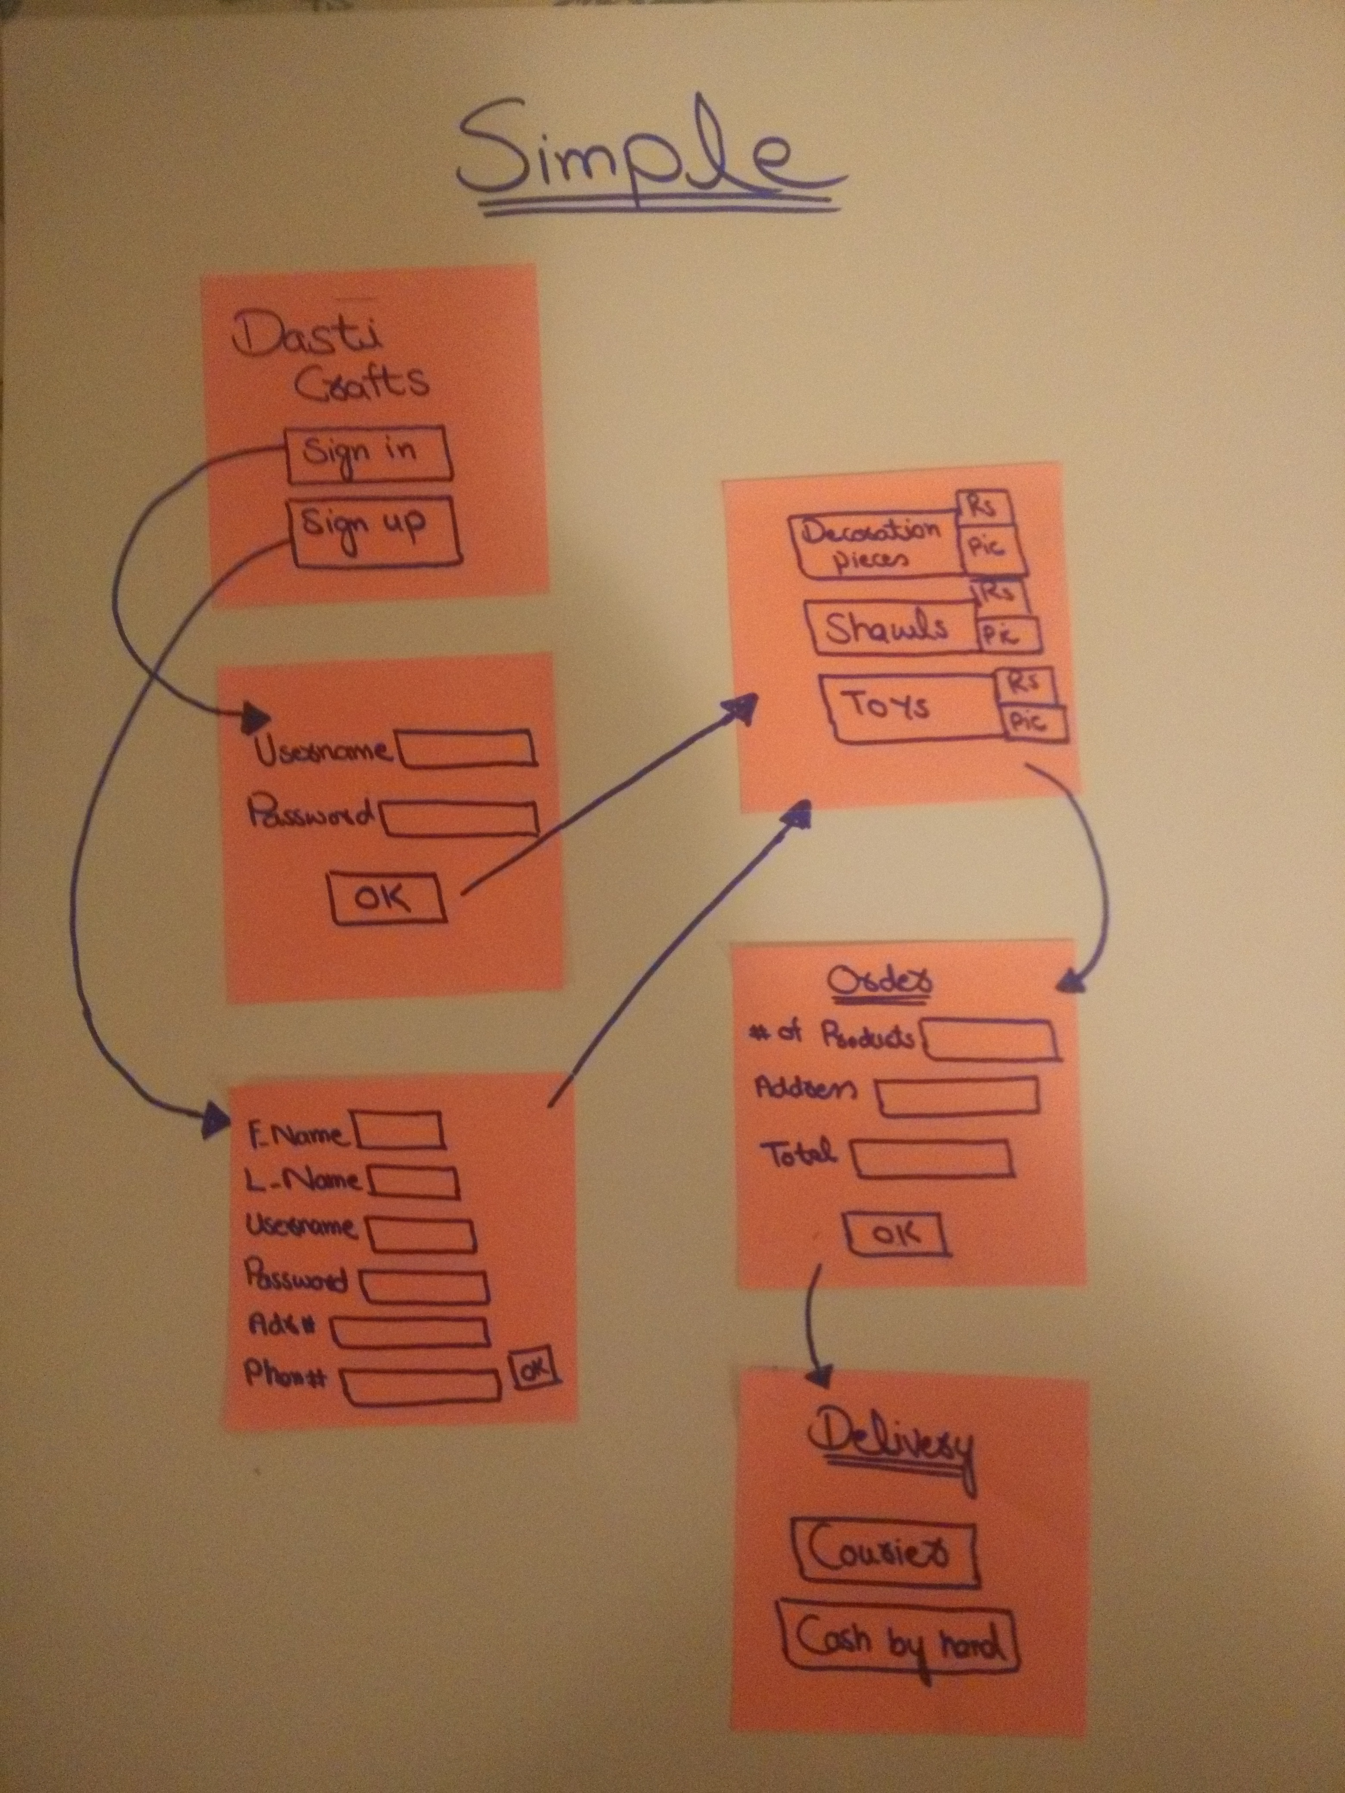
SIMPLE TASK

Slide 6
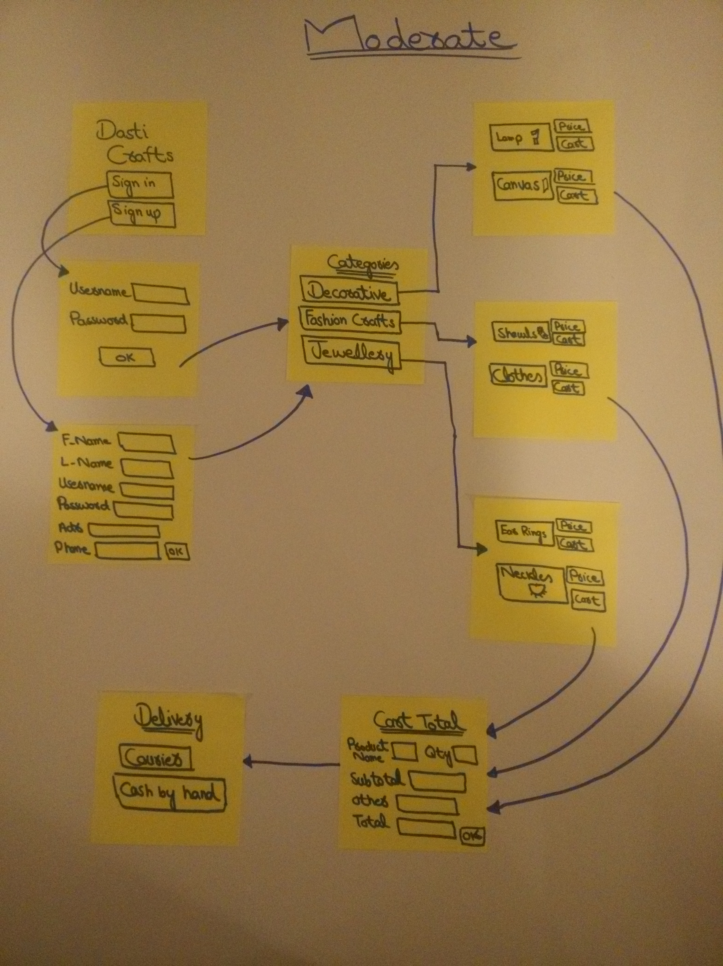
MODERATE
TASK

Slide 7
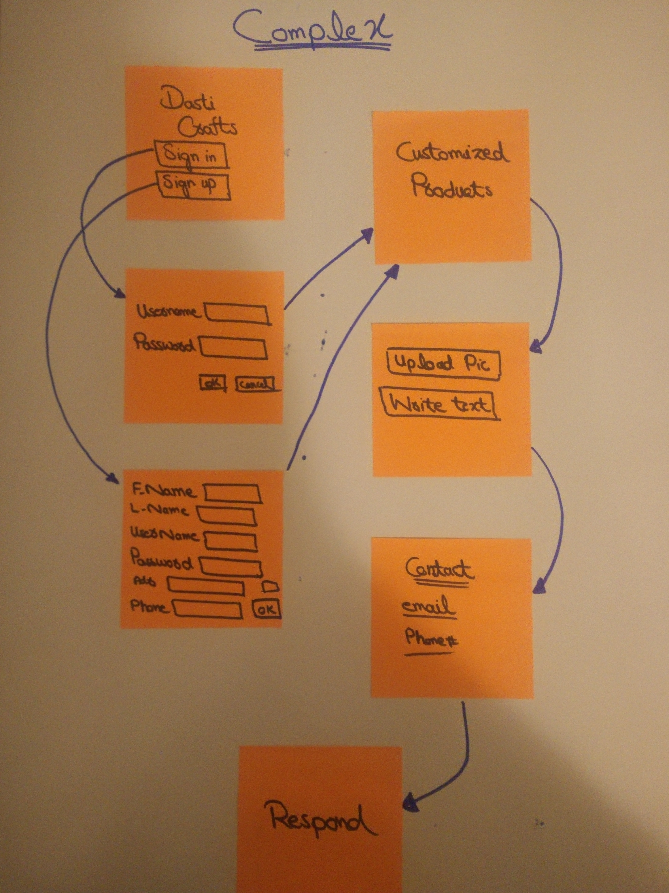
Complex Task

Slide 8
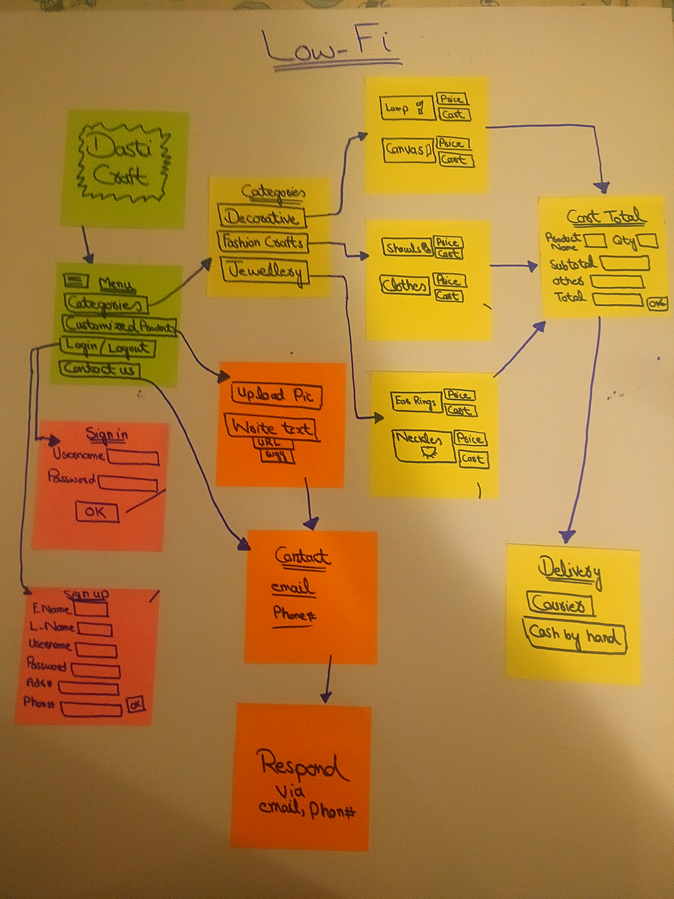
LOW-FI
PROTOTYPE

Slide 9
EXPERIMENTAL METHOD
Participant #1
Working male
Late 30’s – 35’s
Has been using different apps
Participant #2
Student boy
early 20’s
Participant #3
Female
Teacher
Don’t use apps frequently
Location/Time: University and Home on Sunday.

Slide 10
RESULTS
Participant #2
Understood the UI for all the tasks
There should be price filter.
Help section is missing
Participant #3
“Self-explanatory” UI
Some headings were not very clear
Confused by the complex task
Participant #1
Verbalized understanding of the UI
How to go back to certain section
There should de a detail section of products.
Notes:
TEST MEASURES
Time it took the user to comprehend and move onto the next screen
Positive verbal affirmations
Assumptions, both correct and incorrect
Questions related to functionality
Number of pauses (getting stuck)

Slide 11
SUGGESTED UI CHANGES
“It would be better if I can edit the list of products I am going to buy”
There should be a help section
There should be written some text with the headings to explain their meaning
There should be a price filter

Slide 12
SUMMARY
Overall, our UI was intuitive and logical!
Main Issues:
There was no help section
Detail of products
Price filter
Future Steps:
Implement the suggestions given by the participants
Simpler, concise steps
Notes:
The biggest source of confusion during our tests was the complex task. As a result, we intend to remedy this by both fixing the home screen as well as fleshing out the specifics of the complex task. For the home screen, which currently just has two buttons (“Start Journey” and “View Past Journeys”), we will change this to be three buttons where each corresponds to a task (“Start Journey”, “View Past Journeys”, and “Discover Art Taste”). This will help users draw the distinction between the moderate task, which only looks at one museum visit, and the complex task, which aims to collect patterns and draw insights across all museum visits. This coming week, we aim to further explore what exactly our goal is with the complex task and make the screens more clear to reflect this.

Slide 13
THANK YOU!

